Slide 1
Welcome

Slide 2
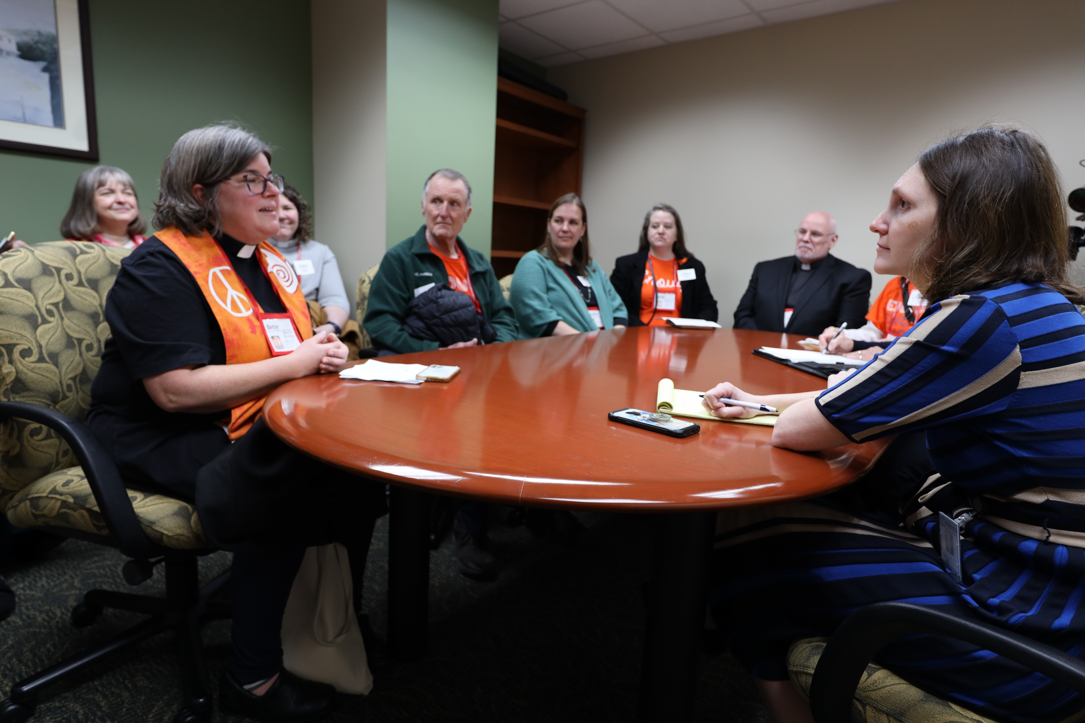
Let’s Talk About Power and Plans
With leaders from the Board of Justice
Albert Rush, chair of Church and Society
Dale Milford, co-chair of Religion and Race
Michelle King, chair of Disability Concerns and Advocacy Day assistant
And Alice Fleming Townley, Advocacy consultant

Slide 3
Prayer
Albert Rush

Slide 4
What words do you associate with power?
Michelle King

Slide 5
What words do you associate with power?
Influence, Control, Authority, God
Unequal
Oppression
Domination
The ability to act
Money
Upwelling
Wealth
Strength/weakness
Opportunity to serve
Agency
Education
Privelege
Entitlement
Transference
Takes power to be human
Miltary
Dominance
Larger
Can be shared and enlarged
Ranked
Efficacy, connections, inherited, laws, coercive and pursuasive power, position,

Slide 6
The Image of the Axe. . . .power for good.

Slide 7
Types of Power
Dale Milford

Slide 8
What is Power?

Slide 9
Money

Slide 10
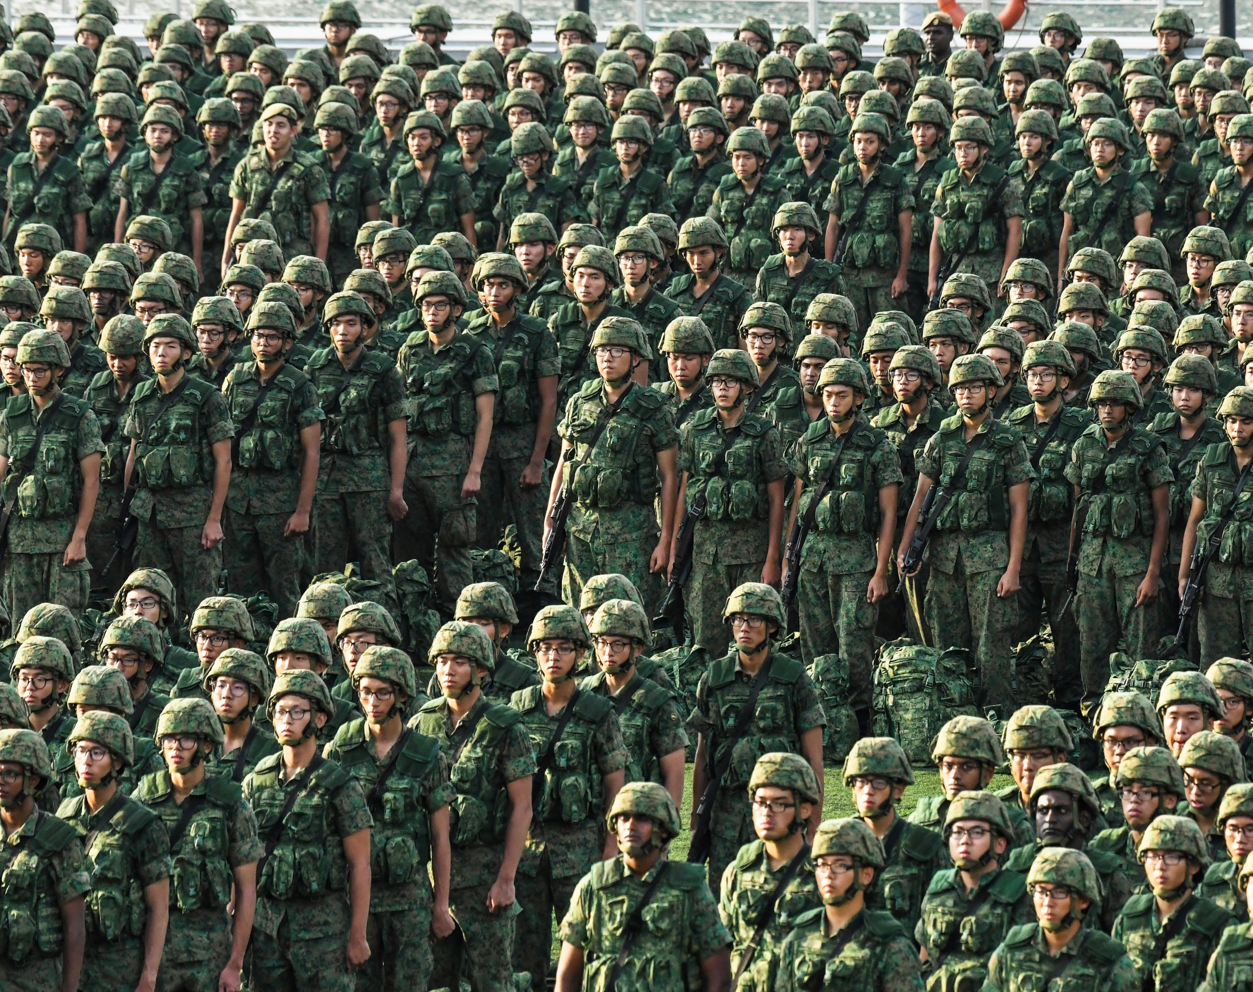
Military

Slide 11
People Power

Slide 12
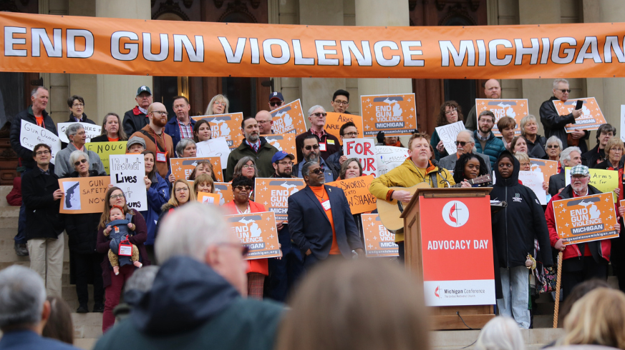
WE Can Make a Difference

Slide 13
Jesus and Power

Slide 14
Theological
Grounding
Luke 18:1-8
Matthew 25:31-45

Slide 15
Stories
Methodist Miracle story
United Methodist at a critical time
Words of Anticipation
It takes a village
Letters of support brought tears
Those who couldn’t come also made an impact
See something, do something
Be adaptive

Slide 16
Advocacy Day Plans
Central United Methodist Church, 215 North Capital Ave, Lansing, MI 48933
Event page and registration

Slide 17
All are Welcome
United Methodists and Friends
Registration Cost:
Sliding scale, $30 recommended

Slide 18
Donations
Advocacy Day as an annual event
Samaritan Counseling Center
EngageMI conference project
Provides counseling in several UM churches in SE Michigan

Slide 19
Lunch and Learn
February 15
12:15pm
Streamed to Michigan Conference Facebook page

Slide 20
Register by February 25
For lunch and appointment reservations, register in advance.
Walk ins will also be welcome.

Slide 21
Pre-event trainings
Advocacy Training #1: Tuesday, February 20, 7pm, 'A Roadmap' with Tori Booker, Advocacy and Outreach Manager for Immigration Law and Justice Michigan.
Advocacy Training #2: Monday, February 26, 7pm, 'Insights' with State Representative Julie Rogers, Chair of House Health Policy Committee; and State Representative Felicia Brabec, Chair of the Health Policy Subcommittee on Behavioral Chair.

Slide 22
600 Semi-Colon Butterflies
421 on Capitol lawn
One for each legislator to be delivered with visits and letters
Giant semi-colon butterfly being commissioned by BOJ
May be sent in advance to Central UMC: 215 North Capital Ave, Lansing, MI 48933

Slide 23
Schedule
*All times Eastern Standard Time 7:30 AM Registration and refreshments 8:30 AM Welcome 9:30 AM - 11:30 AM - Advocacy Activites 11:30 AM - Press Conference 12:15 PM - Lunch 1:00 PM - Worship Official events conclude after worship. Capitol tours are optional at 2:30 PM and 3:00 PM. Sign-up is included in the registration form.

Slide 24
Advocacy Activities
Meetings with legislators
Poster making for press conference
Letter writing
Prayer in the rotunda
Prayer in the sanctuary
Public witness on the Capitol lawn (art display and resource table)
Introductions in the House and Senate chambers
Butterfly display

Slide 25
Legislative Priorities
Parity Bill
HB 4707
Certified Community Behavioral Health Clinics
HB 5371 and 5372
Funding support

Slide 26
Hotel Block
A block of rooms is available at Hyatt Place Lansing - East, 2401 Showtime Dr., Lansing, MI 48912
The rate of $109 + tax is available from Tuesday, March 12 - Thursday, March 14.
Use the link below to book, or call Hyatt Reservations at 888.492.8847 and mention group code G-UMC3.
Group rate is available through February 20, 2024.
Hyatt Place Lansing Booking Link

Slide 27
Debrief
Tuesday, March 20, 7pm
Same zoom link

Slide 28
Questions and Answers

Slide 29
Next Action Step
Invite people to REGISTER for Advocacy Day
Registration Deadline for appointments and lunch is February 25
Contact your legislators now and let them know you are coming and why
If they want to schedule with you now, share with: advocacy-day@michiganumc.org
Attend coffee hours that senators and representatives have and share you support of increased mental health access. Ask them about their support for the parity bill.

